Slide 1
Annotation tools

Slide 2
Summary
There are two script tools:
Tool for surface annotation (include surface name only)
Tool for thermal model annotation. Annotation include zone name, surface name, HTC and Tsink values at steady state, amplitude names.
Scripts are designed for the following programs:
Abaqus CAE: script tools are available
- surface_annotation_gui.py
- surface_annotation_gui_sfilm_flux_amplit.py
Ansys Mechanical: Not available. Not enough functionality for creation.
Ansys APDL: Development preparation is ongoing.

Slide 3
ABAQUS CAE scripts

Slide 4
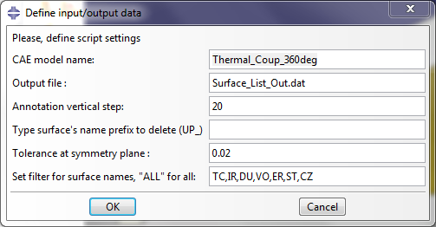
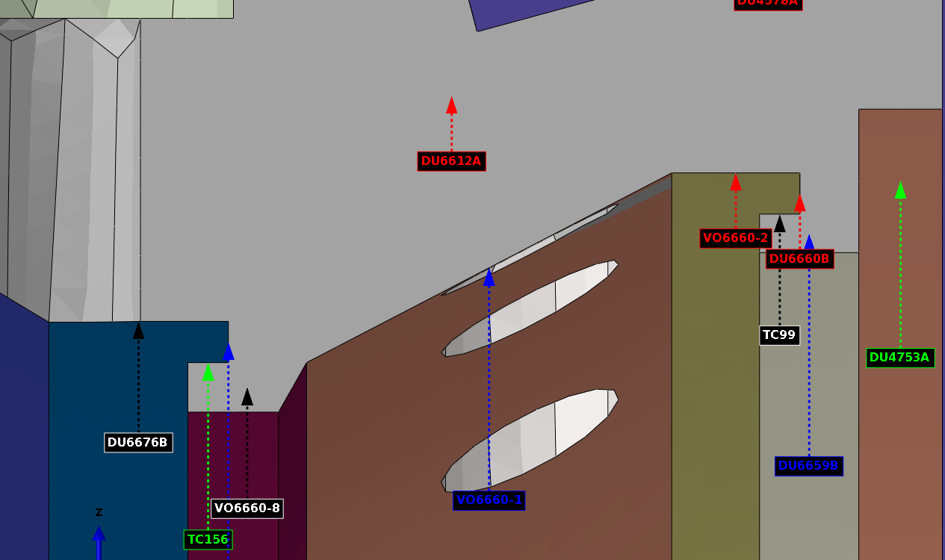
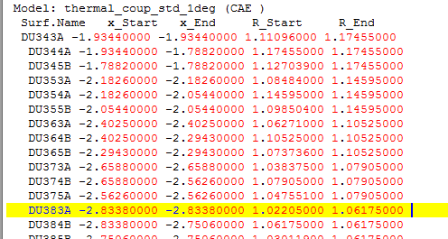
ABAQUS CAE Scripts
Tool #1. Surface annotation example
Tool is creating a text file with the following output
Surfaces without intersection with symmetry plane pointed at it’s the first node
Surface’s annotation arrow is pointing the middle of surface at symmetry plane

Slide 5
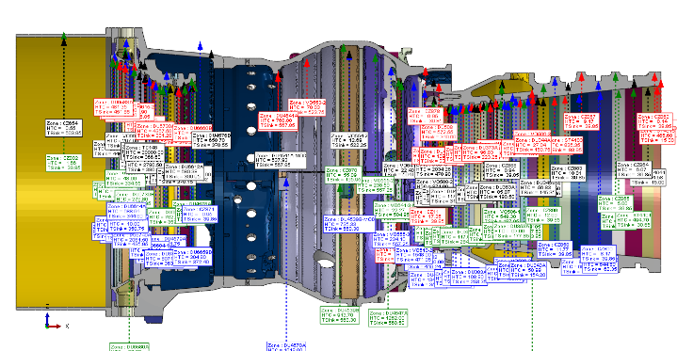
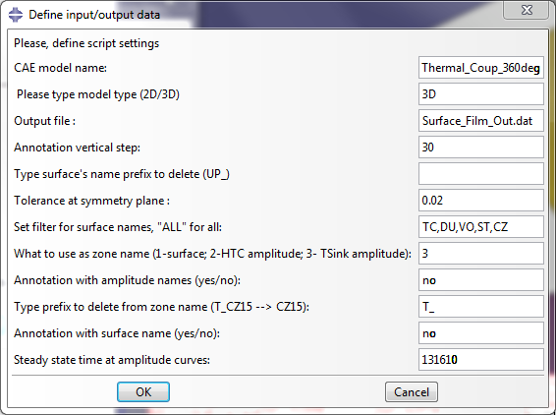
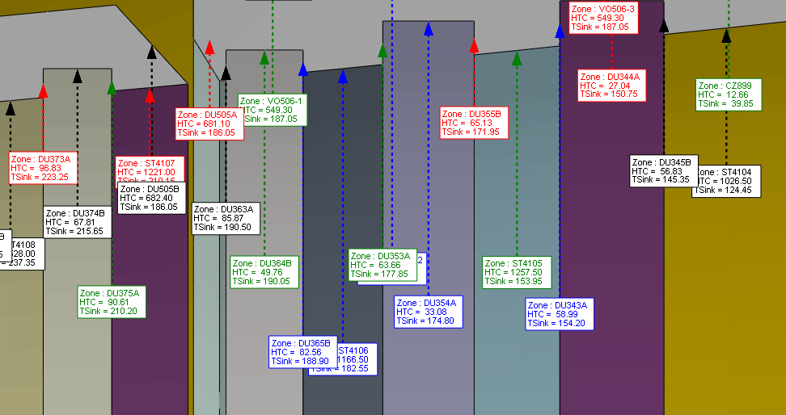
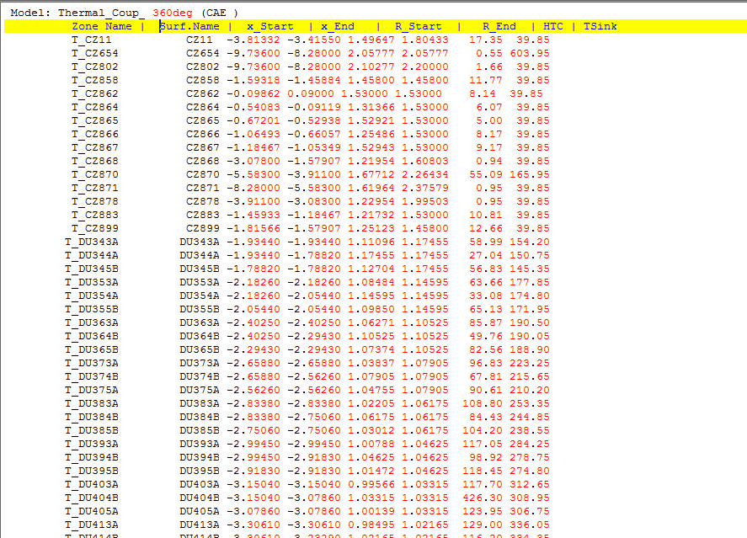
ABAQUS CAE Scripts
Tool #2. Sfilm condition annotation example Reduced output
Surface’s annotation arrow is pointing the middle of surface at symmetry plane

Slide 6
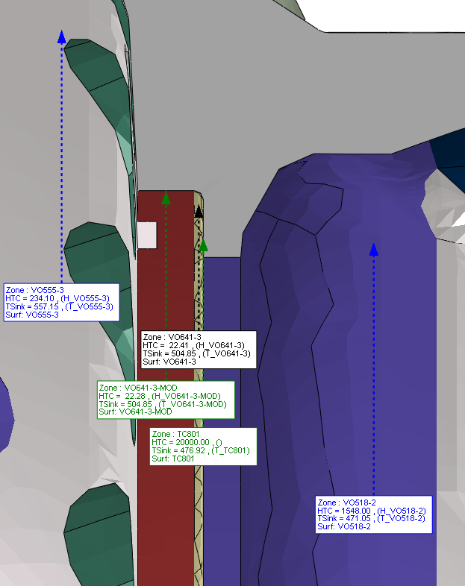

ABAQUS CAE Scripts
Tool #2. Sfilm condition annotation example Full output
Tool #2 use CAE thermal model as source of values. In the case of amplitude curve defined for the sfilm condition, it will use an multiplication of factor value and amplitude value for the specified steady state time
Surface’s annotation arrow is pointing the middle of surface at symmetry plane

Slide 7
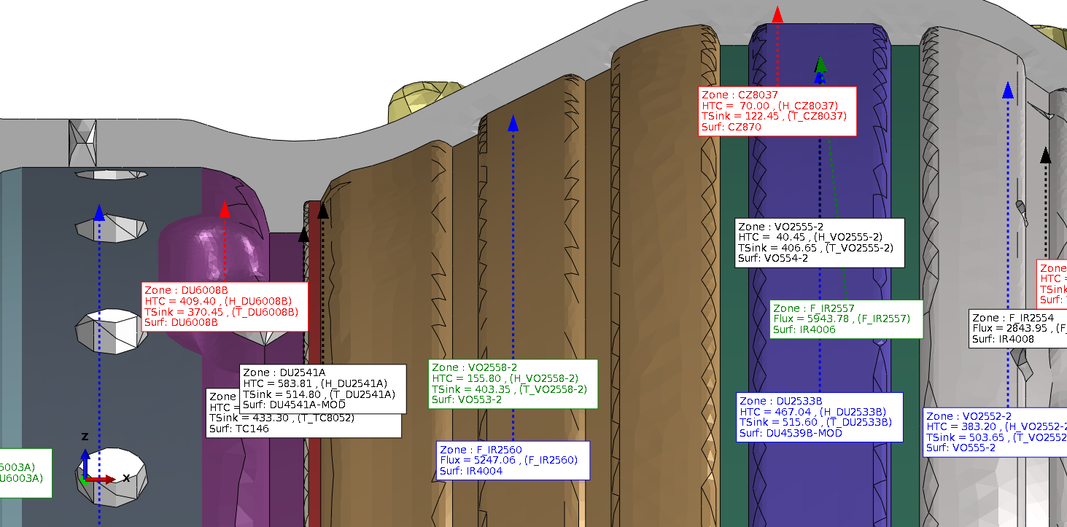
ABAQUS CAE Scripts
Tool #2 use CAE thermal model as source of values. In the case of amplitude curve defined for the sflux condition, it will use an multiplication of factor value and amplitude value for the specified steady state time
Surface’s annotation arrow is pointing the middle of surface at symmetry plane

Slide 8
ANSYS Workbench

Slide 9
Ansys Mechanical Scripts
Graphics annotation can be created with the following:
Point = ExtAPI.Graphics.CreateWorldPoint
Pt = Point(0.1, 0, 0)
Label = ExtAPI.Graphics.Scene.Factory2D.CreateText(Pt, "Testing")
Label.Color = 0x000000
But after consultation with Santhosh M from Ansys India, Bangalore. It was resaved the following:
It seems ExtAPI.Graphics.Scene.Factory2D.xxx API was quite unstable in the past.
As per out data base ExtAPI.Graphics.Scene.Factory2D. worked only 16.2 and 18.1. Broke in 17.0, 17.1, 17.2, 18.0, 18.2, etc,..
I tested in on latest V2019R1, I seems working as shown below.
“ Dear Victor,
I explore further and discussed with Ansys development team responsible for Graphics APIs.
In conclusion, this is an area that we're looking to cover in upcoming releases, but right now there are no tested and reliable ACT APIs for your annotations requirement. “
Conclusion: Now Ansys Mechanical have no technical abilities to create the tools

Slide 10
As solution: Workbench -> APDL
Abilities to customize Ansys APDL and to create the tools:
C, C++, or Fortran The Mechanical APDL program has an open architecture, allowing you to write your own routines or subroutines in C, C++, or Fortran and either link them to the program or use them as external commands. Some standard program features originated as user customizations, also known as user programmable features (UPFs).
UIDL You can change the menu hierarchy to suit your analysis needs, alter the design of many of the dialog boxes and add your own macros (in the form of dialog boxes) to the menu hierarchy To modify the dialog boxes and main menus, use the ANSYS, Inc.-developed GUI programming language, called the User Interface Design Language (UIDL). For more information, see the ANSYS UIDL Programmer's Guide. (The guide is not part of the standard Mechanical APDL documentation set but can be ordered separately.)
APDL APDL stands for ANSYS Parametric Design Language, a scripting language that you can use to automate common tasks or even build your model in terms of parameters (variables). APDL supports all ANSYS commands and encompass a wide range of other features such as repeating a command, macros, if-then-else branching, do-loops, and scalar, vector and matrix operations, interfacing with GUI.

Slide 11
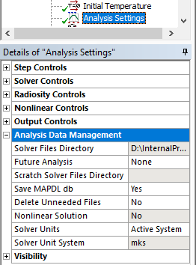
Workbench -> APDL
Folder for APDL database and results:
\dp0\SYS-1\MECH
APDL:
Temperature (TEMP):
List -> Loads -> DOF Constraints ->
On All Nodes
Convection (CONV) & Heat Flux (HFLU):
List -> Loads -> Surface -> On All Nodes

Slide 12
ANSYS APDL

Slide 13
APDL Commands for an annotation
/AN3D, Kywrd, KEY - specifies 3-D annotation features
Kywrd = TEXT – a text string.
Kywrd = LINE – a line.
Kywrd = AREA – a polygonal area
Kywrd = ARRO – an arrow
/AN3D,TEXT,X,Y,Z,Text_String
X, Y, Z - coordinates for text string.
Text_String - text string.
/AN3D,LINE,X1,Y1,Z1,X2,Y2,Z2
X1, Y1, Z1 - coordinates for beginning of line.
X2, Y2, Z2 - coordinates for end of line
/AN3D,AREA,NVERT,Xn,Yn,Zn
NVERT – the number of the polygon.
Xn, Yn, Zn - coordinates for vertex n
/AN3D,ARROW,SIZE,X1,Y1,Z1,X2,Y2,Z2
SIZE - Symbol size multiplier (0.1 to 20.0, default = 1.0) for the head of the arrow
X1, Y1, Z1 - coordinates for beginning of line.
X2, Y2, Z2 - coordinates for end of line

Slide 14
APDL Commands for an annotation
/TSPEC, TCOLOR - specifies annotation text attributes
/LSPEC, LCOLOR – specifies annotation line attributes
TCOLOR | Color | R | G | B | TCOLOR | Color | R | G | B
0 | Black | 0 | 0 | 0 | 8 | Green | 0 | 255 | 0
1 | Red-Magenta | 255 | 0 | 179 | 9 | Yellow-Green | 179 | 255 | 0
2 | Magenta | 255 | 0 | 255 | 10 | Yellow | 255 | 255 | 0
3 | Blue-Magenta | 179 | 0 | 255 | 11 | Orange | 255 | 192 | 32
4 | Blue | 0 | 0 | 255 | 12 | Red | 255 | 0 | 0
5 | Cyan-Blue | 0 | 179 | 255 | 13 | Dark Gray | 179 | 179 | 179
6 | Cyan | 0 | 238 | 200 | 14 | Light Gray | 230 | 230 | 230
7 | Green-Cyan | 0 | 255 | 179 | 15 | White | 255 | 255 | 255

Slide 15
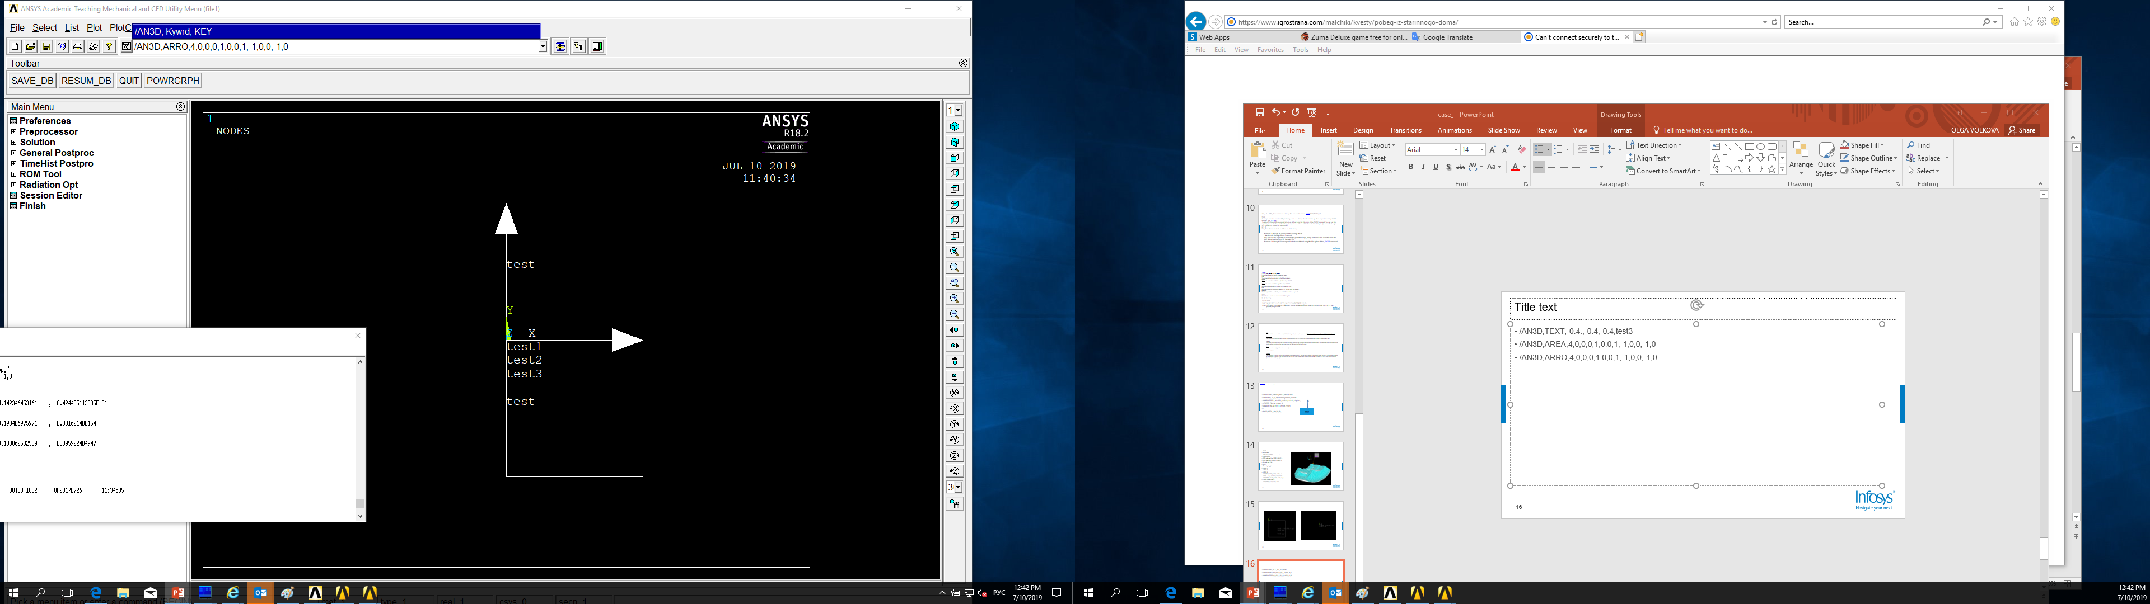
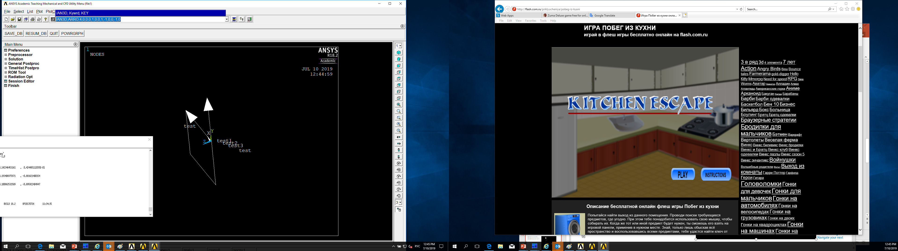
APDL Commands for an annotation - Example
/AN3D,TEXT,-0.4.,-0.4,-0.4,test3
/AN3D,AREA,4,0,0,0,1,0,0,1,-1,0,0,-1,0
/AN3D,ARRO,4,0,0,0,1,0,0,1,-1,0,0,-1,0
The a polygonal area and text are rotated and moved. Commands for text and polygonal area annotations don’t allow create usable multi-line annotations.

Slide 16
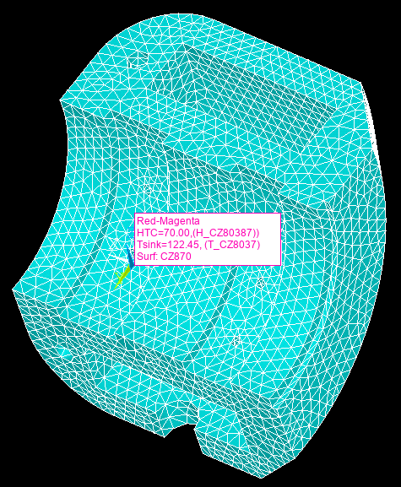
APDL Commands for a texture annotation
/TXTRE,File,TYPE,FName,png,,2
TYPE - An integer value between 1 and 99, indicating a texture or bitmap
FName - File name and directory path (248 characters maximum, including the characters needed for the directory path). An unspecified directory path defaults to the working directory; in this case, you can use all 248 characters for the file name
/AN3D,BITM,TYPE,X,Y,Z
TYPE - An integer value between 1 and 99, indicating a texture or bitmap
X, Y, Z - coordinates for the lower left corner of the bitmap.
Numbers 1 through 40 correspond to existing ANSYS textures. Numbers 41 through 50 are reserved. Numbers 51 through 57 are logo, clamp and arrow. Numbers 58 through 99 can be used to load 42 texture annotations.

Slide 17
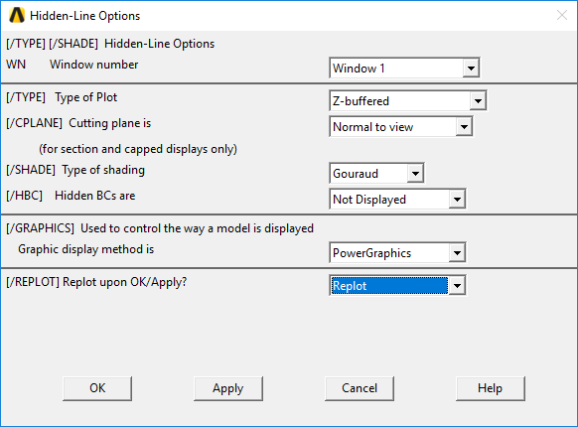
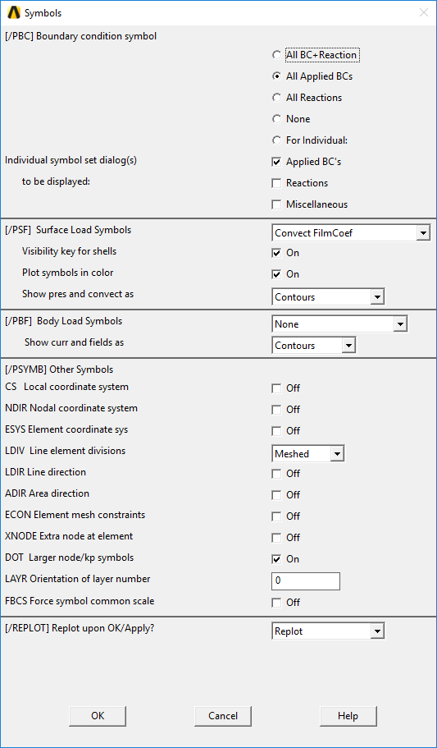
Zone Visualization. BCs
PlotCtrls -> Style -> Hidden Line Options
PlotCtrls -> Symbols
Zones are colorized according to values (HTC, BulkTemp, HFlux)
Temp BCs are markers and have same color for different zones
Different pictures for Flux and HTC

Slide 18
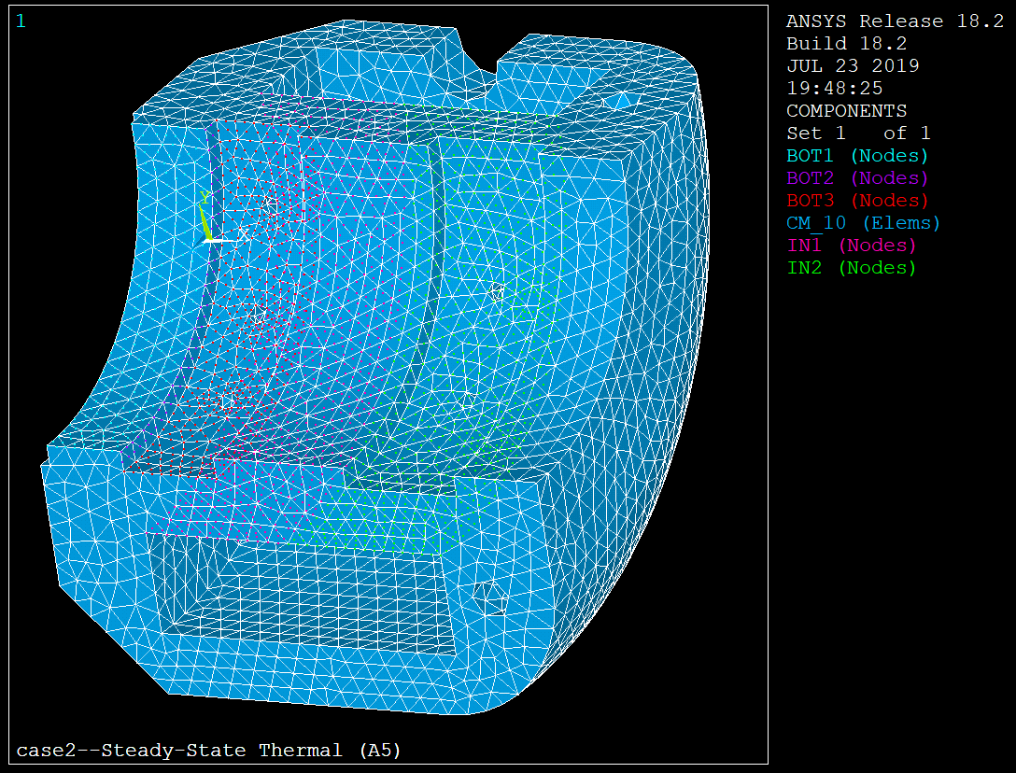
Zone Visualization. Components
Workbench creates components for nodes where BCs are applied
To visualize:
Plot -> Components ->
Selected Components
CMPLOT,ALL
Issues:
Nodes are bad for visualization
Elements are transparent for nodes

Slide 19
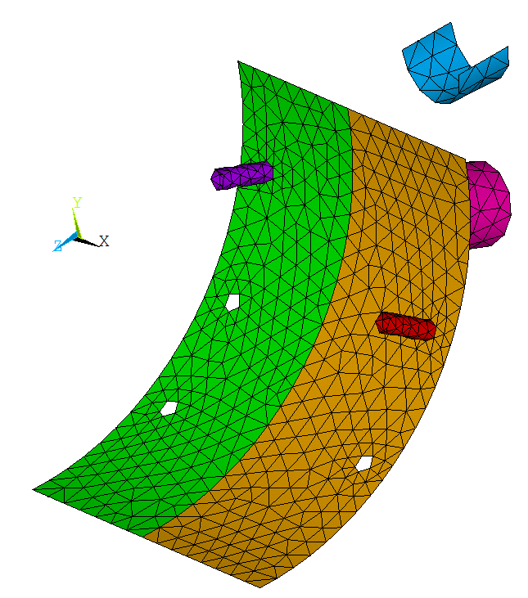
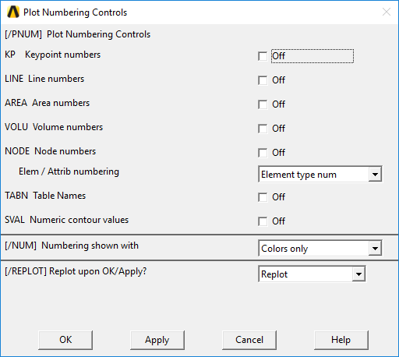
Zone Visualization. Surface Elements
Workbench creates surface elements with different type numbers for BCs – for HTC, Heat Flux
To Visualize:
PlotCtrls -> Numbering
/PNUM,TYPE,0
Issues:
Solid elements aren’t colorized. Surface elements must be created for free surfaces to get a full view of the solid

Slide 20
Main issues and solutions for APDL
Target:
To do annotation of tBCs zone in symmetry plane →
It should be possible to zoom and shift area with annotations, to get more details.
APDL limitations (known)
No text annotation with multiple lines
Annotation text will not scale with zoom
Annotation were built as overlapping arrow, box, text line1, text line2. They will runaway during zoom process.
APDL solutions (more details on next slide)
Generate bitmaps with zone information and put it on screen (BITMAPS)
Draw all information as overlapped vector drawing. Add button redraw after zooming (VECTOR-REDRAW)
Create several BUTTONS to show one-line information only
Zone A
HTC = 100
Tsink = 200

Slide 21
APDL methods for annotations
Solution Method | Pro | Contra | Required information/ knowledge | Difficulty
BITMAPS Generate bitmaps and place them as annotation | All zones’ figures will be ready for application. Bitmaps might be generate in the external tool | All figures will be static Additional system of figures storage and access | Possibility to create bitmaps by APDL commands for the selected region Bitmap behavior during zoom and shift | Medium
VECTOR-REDRAW Generate smart annotation overlapped. Redraw procedure after shift/zoom process | Independent from storage interaction Free to add or to remove information from annotation | Difficult procedure of relation definition between real coordinates and viewport coordinates | Create method to measure relation between real coordinate and viewport position Create relation table of font size and annotation position | High
BUTTONS Create set of buttons to display one-line information | Simple to realize No need(?) to redraw during scale and shift view | The annotation will contain information about one field only It will be required to create several figures for each zone | Buttons creation | Low
Conclusion: Search another solution

Slide 22
ParaView

Slide 23
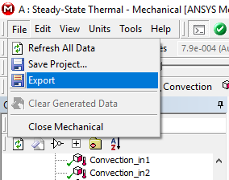
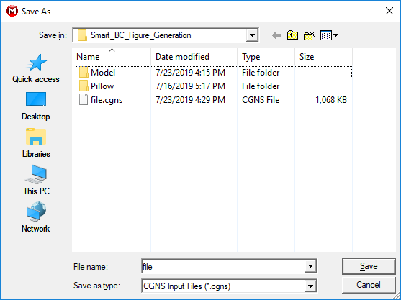
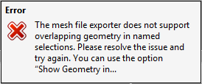
Workbench export to ParaView
Python command for import:
filecgns = CGNSSeriesReader(FileNames=[Dir+GeomFileName])
filecgns.Blocks = BlocksList

Slide 24
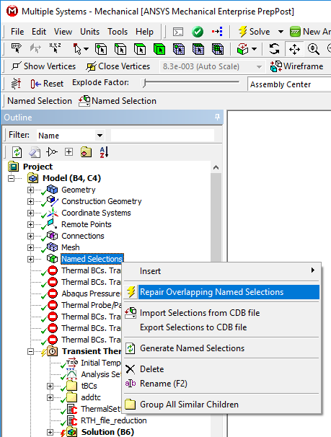
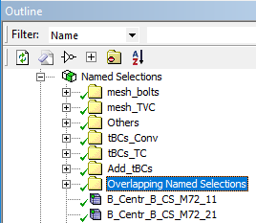
Workbench export to ParaView. Problems
CNGS doesn’t allow overlapping geometry in named selections.
Named Selections with overlapping geometry should be deleted

Slide 25
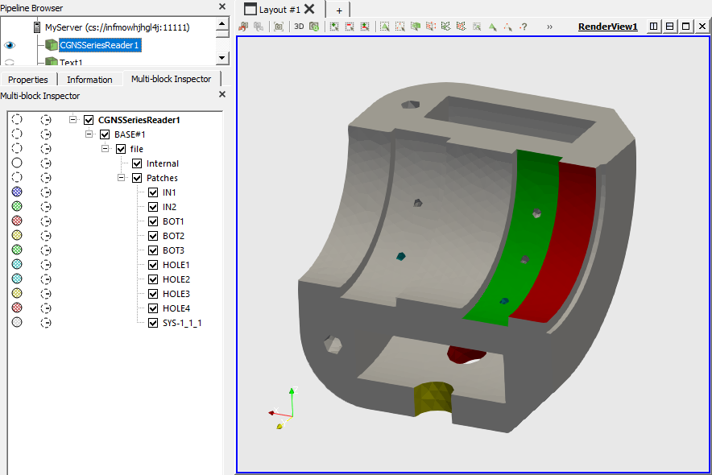
Named Selection visualization in Paraview
renderView1 = GetActiveViewOrCreate('RenderView')
filecgnsDisplay = Show(filecgns, renderView1)
ColorBy(filecgnsDisplay, ('FIELD', 'vtkBlockColors'))
vtkBlockColorsLUT = GetColorTransferFunction('vtkBlockColors')
vtkBlockColorsLUT.IndexedColors[3*i] = 0.75 – # value for red (0.0…1.0)
vtkBlockColorsLUT.IndexedColors[3*i+1] = 0.75 – # value for green (0.0…1.0)
vtkBlockColorsLUT.IndexedColors[3*i+2] = 0.75 – # value for blue (0.0…1.0)

Slide 26
Access to vtkMultiBlockDataSet in Paraview. CGNS
full_data = servermanager.Fetch(filecgns)
BlockArr=full_data.GetBlock(0).GetBlock(0).GetBlock(1)
for i in range(0,BlockArr.GetNumberOfBlocks()):
SelBlock=BlockArr.GetBlock(i)
#-----Name---------
Info=BlockArr.GetMetaData(i)
BlockName=Info.Get(BlockArr.NAME())
#-----Cells--------
BlockCells=SelBlock.GetCells()
CellsNum=BlockCells.GetNumberOfCells()
CellDat=BlockCells.GetData()
#----Coordinates
Coord=SelBlock.GetPoints().GetPoint(NodeNum)
NOTE: Paraview server should be launched to get access

Slide 27
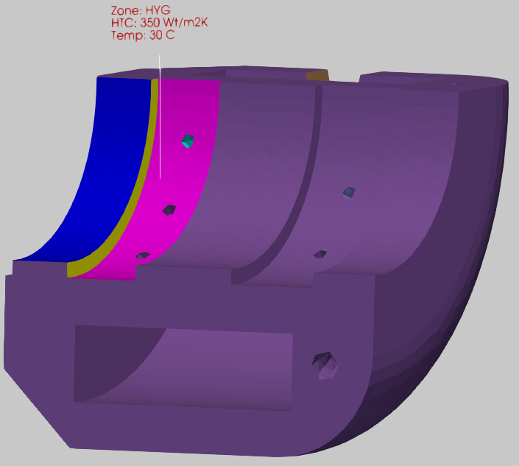
Annotation creation
renderView1 = GetActiveViewOrCreate('RenderView')
...
txt = Text()
txt.Text = ‘Zone: HYG\nHTC:350 W/m2K\nTemp:30 C'
…
txtDisplay=Show(txt, renderView1)
txtDisplay.FontFamily = 'Courier'
txtDisplay.FontSize = FontSize
txtDisplay.Color = [1.0,0.0,0.0]
txtDisplay.Opacity = 0.9
txtDisplay.Bold = 1
txtDisplay.TextPropMode = 'Flagpole Actor'
txtDisplay.BasePosition = [0.12,0.3,0.21]
txtDisplay.TopPosition = [0.12,0.3,0.21]
txtDisplay.TopPosition[VertAxis]+= 0.1
RenameSource(‘HYG’, txt)

Slide 28
Paraview
Paraview capabilities:
There is export from ANSYS Workbench to Paraview through CGNS-file
Named Selection can be visualized and colored by means of Python script
There is access to coordinates of a mesh in Paraview
Color, Text, Font, Position, Arrow Length for an annotation can be changed by means of Python script
Conclusion:
Paraview is the most comprehensive tool to visualize boundary conditions on a geometry
Link for ParaView without installation:
https://www.paraview.org/paraview-downloads/download.php?submit=Download&version=v5.7&type=binary&os=Windows&downloadFile=ParaView-5.7.0-RC1-MPI-Windows-msvc2015-64bit.zip

Slide 29
CGNS import script

Slide 30
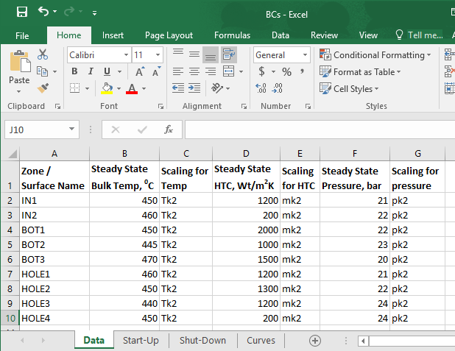
Excel file for CGNS import script
The Excel file is used to calculate transient values of bulk temperature, HTC and pressure for zones
The Excel file is used for applying BCs
The Excel file can be used to create annotations

Slide 31
Python settings to open Excel file
Anaconda contains OpenPyXL library. Python code to turn on OpenPyXL module directly:
import sys
sys.path.append('C:\\Users\\...\\AppData\\Local\\Continuum\\anaconda2\\Lib\\site-packages')
from openpyxl import load_workbook
wb=load_workbook('D:\\...\\BCs.xlsm')
ws=wb.get_sheet_by_name('Data')
…
BlockName=str(ws.cell(i,1).value)
…
wb.close()

Slide 32
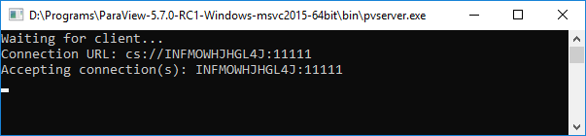
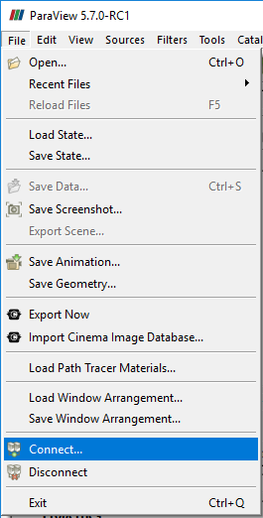
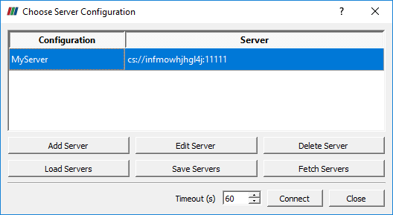
How to run Paraview
Paraview server should be run to get access to full data of objects
Run \bin\pvserver.exe
Open Paraview
Click File\Connect…
Add Server (take hostname from the pvserver window) if It’s necessary. And Connect

Slide 33
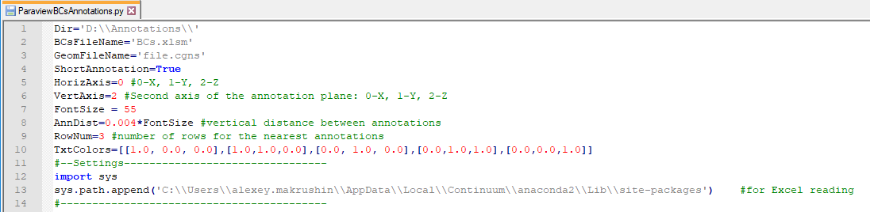
Edit the script
Path and files names
Settings for visualization
Path to Python library for Excel

Slide 34
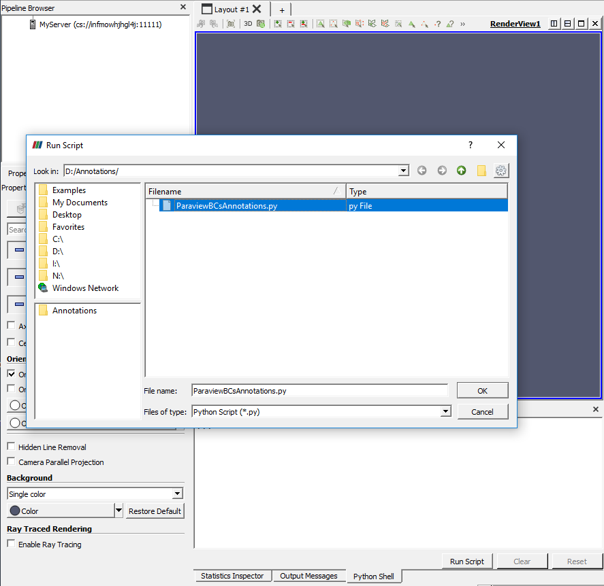
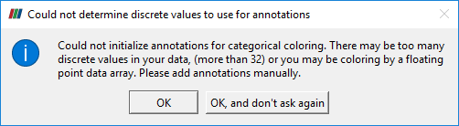
Run the script
Press Python Shell
Press Run Script
Select the script
Press OK
Press OK on message window

Slide 35
ParaView through vtm-file

Slide 36
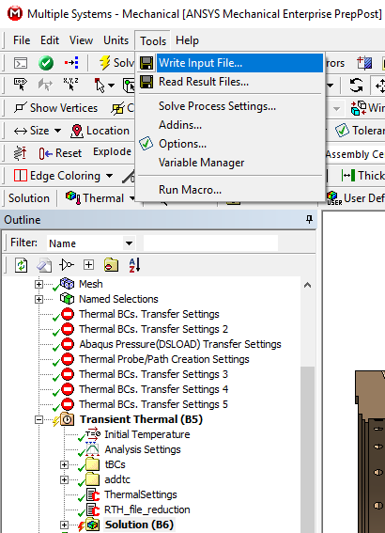
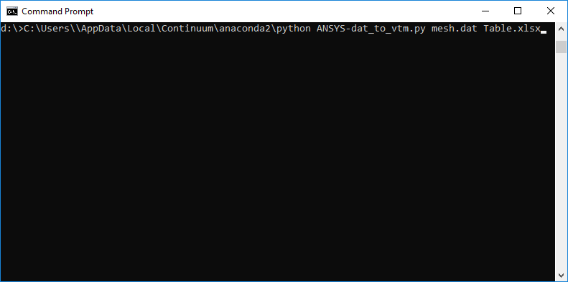
Workbench export to ParaView
1. Create ANSYS dat-file for a Thermal calculation
2. Prepare Excel-file with thermal boundary conditions
3. Run Ansys-dat_to_vtm.py in Command Prompt to create vtm-file for import to Paraview

Slide 37
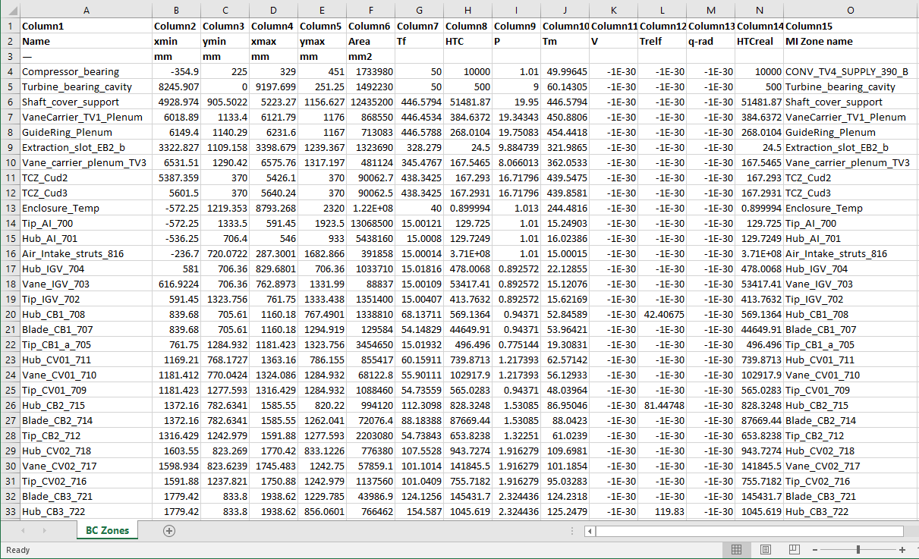
Excel file for creating of VTM file
The Excel file is used to get values for boundary conditions for steady-state
-1E-30 value is used for not used boundary conditions
Zone name
Convection
Temperature
Heat flux

Slide 38
vtkUnstructuredGrid creation
import sys
sys.path.append('D:\\Programs\\ParaView-5.7.0-RC1-Windows-msvc2015-64bit\\bin\\Lib\\site-packages')
import vtk
#-----How create points for a block---------
Points[i]=vtk.vtkPoints()
Points[i].InsertNextPoint(x,y,z)
#-----How create a block---------
Block[i]=vtk.vtkUnstructuredGrid()
Block[i].SetPoints(Points[i])
Block[i].Allocate(CellsNumber)
Block[i].InsertNextCell(vtk.VTK_TRIANGLE,3,[i1,i2,i3])
#-----How write values to the points---------
Array1=vtk.vtkFloatArray()
Array1.SetName('Temp')
Array1.InsertNextValue(Temp)
Array2=vtk.vtkFloatArray()
Array2.SetName('HTC')
Array2.InsertNextValue(HTC)
Block[i].GetPointData().SetScalars(Array1)
Block[i].GetPointData().AddArray(Array2)

Slide 39
vtkMultiBlockDataSet creation
#-----How create MultiBlockDataSet---------
output=vtk.vtkMultiBlockDataSet()
output.SetNumberOfBlocks(BlocksNumber)
output.GetMetaData(i).Set(vtk.vtkCompositeDataSet.NAME(), BlockName[i])
output.SetBlock(i, Block[i])
#-----How write vtm---------
MBDSwriter=vtk.vtkXMLMultiBlockDataWriter()
MBDSwriter.SetFileName(‘File.vtm')
MBDSwriter.SetDataModeToBinary()
MBDSwriter.SetInputData(output)
MBDSwriter.Write()

Slide 40
How to load vtm in Paraview with annotations
Paraview server should be run to get access to full data of objects
Run \bin\pvserver.exe
Open Paraview
Click File\Connect…
Add Server (take hostname from the pvserver window) if It’s necessary. And Connect

Slide 41
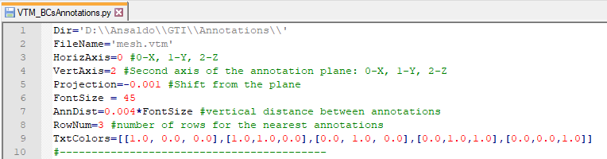
Edit the script
Path and files names
Settings for visualization

Slide 42
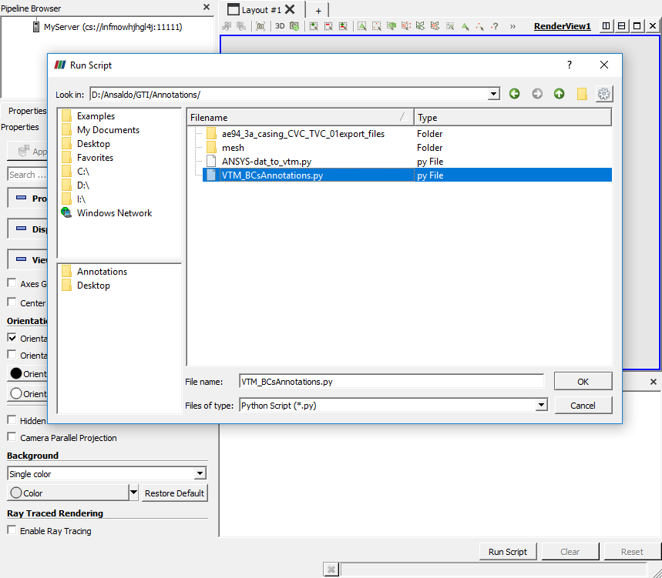
Run the script
Press Python Shell
Press Run Script
Select the script
Press OK
Press OK on message window

Slide 43
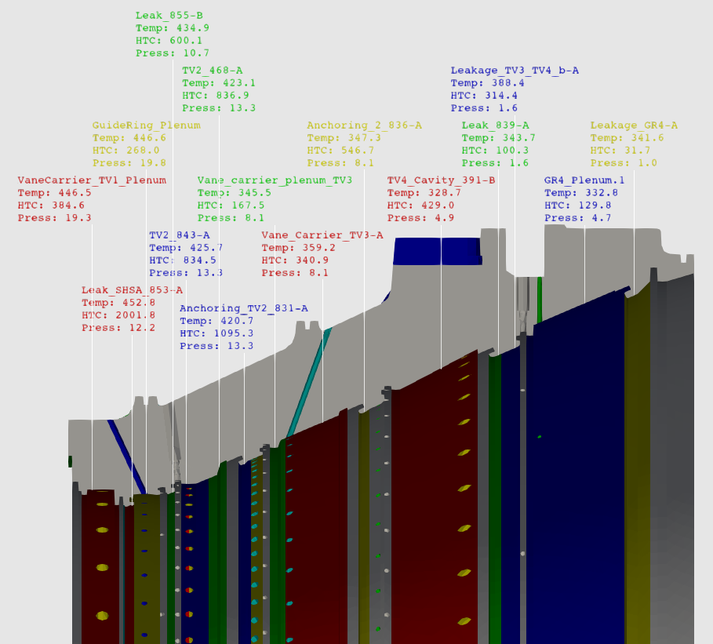
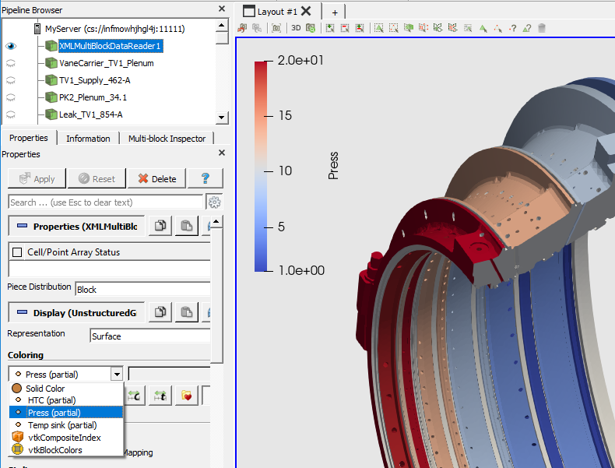
Paraview
Paraview can visualize through vtm:
Named Selections
Values for temperature, pressure, HTC

Slide 44
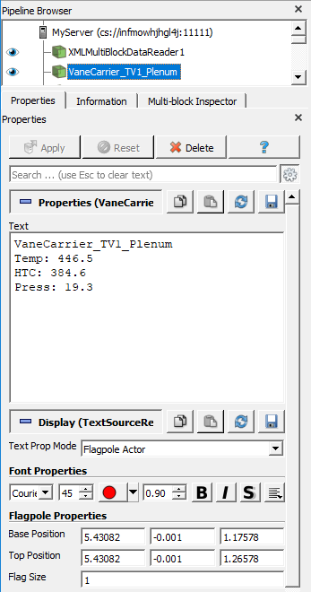
Annotations settings
The following properties can be edited:
Text
Font properties
Coordinates of a line tip (Base Position)
Coordinates of text (Top Position)

Slide 45
ParaView through vtm-file

Slide 46
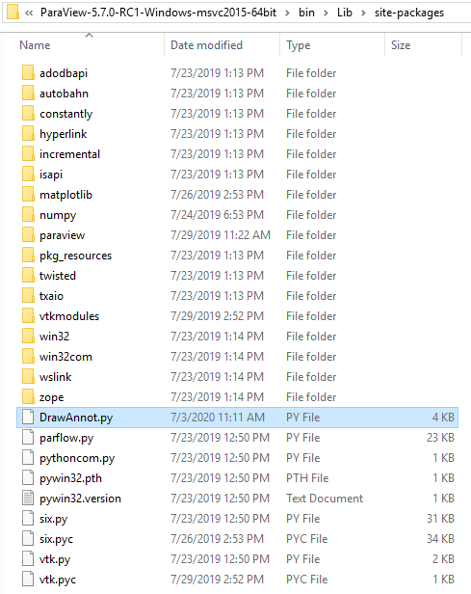
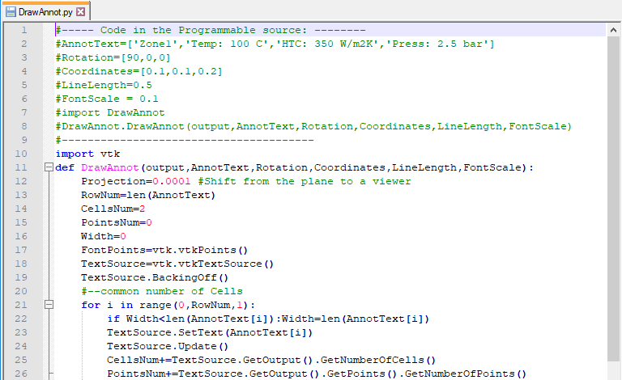
Additional steps of preparation
Copy DrawAnnot.py (a file drawing annotations) in the Paraview library folder to make a procedure being visible

Slide 47
Thank you

Slide 48
Libraries for PNG
C++
PNGwriter - https://github.com/pngwriter/pngwriter/tree/master/pngs
LibPNG - http://www.libpng.org/pub/png/libpng.html
Python
Pillow https://pillow.readthedocs.io/en/stable/index.html

Slide 49
pyCGNS
CFD General Notation System: https://cgns.github.io/
pyCGNS (PAT, NAV, VAL, APP): https://github.com/pyCGNS/pyCGNS
Python package:
import sys
sys.path.append(‘D:\\pyCGNS')

Slide 50
Python to exe
Cython (0.29.2) should be in C:\Users\...\AppData\Local\Continuum\anaconda2\Scripts
Otherwise: launch C:\Users\...\AppData\Local\Continuum\anaconda2\Scripts\pip install Cython
Command for creation c-file: cython --embed CreatePNGsforData.py
set PATH=C:\mingw64\bin (if gcc compiler isn’t installed properly)
gcc -Os -DSIZEOF_VOID_P=8 -DMS_WIN64 CreatePNGsforData.c -IC:\Users\...\AppData\Local\Continuum\anaconda2\include -LC:\Users\...\AppData\Local\Continuum\anaconda2\libs -Ipython27 -o CreatePNGsforData
To run the compiled exe-file (if python isn’t installed properly):
set PATH=C:\Users\...\AppData\Local\Continuum\anaconda2
set PYTHONPATH=C:\Users\...\AppData\Local\Continuum\anaconda2\Lib
set PYTHONHOME=C:\Users\...\AppData\Local\Continuum\anaconda2
Errors otherwise: ImportError: No module named site; can’t find python27.dll

Slide 51
VTK
vtkPVServerManagerApplication-pv5.7.dll
<RepresentationProxy class="vtkTextSourceRepresentation“, name="TextSourceRepresentation“, processes="client|dataserver|renderserver“, si_class="vtkSIProxy">
IntVectorProperty command="SetTextPropMode“ – Entry text="Flagpole Actor“
SubProxy command="SetTextWidgetRepresentation“ - Property name="Color" function="Color"
SubProxy command="SetFlagpoleLabel“ - Property name="BasePosition“, Property name="TopPosition“
vtkView.AddRepresentation()
vtkRenderer.AddActor()
vtkPVClientServerCoreRendering-pv5.7.dll
vtkTextSourceRepresentation (vtkPVDataRepresentation)
TextWidgetRepresentation
I
vtk3DWidgetRepresentation
I
vtkWidgetRepresentation

Slide 52
VTK
Type | Standard sources | Output Data Set type for Programmable Source
Polygonal Mesh | a2DGyph, a3DText, Arrow1, Axes, Box, Cone, Cylinder, Disk, Line, Outline, Plane, PointSource, PolyLineSource, Ruler, Sphere, SplineSource, SuperQuadratic | vtkPolyData
Overlapping AMR Dataset | AMRCaussianPulseSource
Table | AnnotateTime, Text | vtkTable
Image(Uniform Rectilinear Grid) | DataObjectGenerator, FastUniformGrid, Logo, Mandelbrot, Wavelet | vtkImage
AMR Dataset (Deprecated) | HierarchicalFractal | vtkHierarchicalBoxDataSet
Hyper-tree Grid | HyperTree Grid, HyperTree GridRandom
Structured (Curvilinear) Grid |  | vtkStructuredGrid
Rectilinear Grid |  | vtkRectilinearGrid
Unstructured Grid | TimeSource, UnstructuredCellType | vtkUnstructuredGrid
MultiBlock DataSet |  | vtkMultiBlockDataSet
Molecule |  | vtkMolecule

